Slide 1
5 Things to Teach Your Kids About Money

Slide 2
Only 26% of 13-21 year olds say that their parents taught them how to manage money.
*according to the Jump$tart Coalition for Personal Financial Literacy

Slide 3
Mission: Teach Kids About Money
Who: Children of all ages
What: Teaching children the value of a dollar, needs vs. wants, budgeting, saving, credit cards
When: It’s never too early or too late to talk to your kids about money.
Why: Building good money habits early on will help kids better manage their finances in the future.
How: Lead by example and follow these tips from ACCC

Slide 4
The Value of a Dollar: Money doesn’t grow on trees.
When: Grades K-2
Why: When kids see money come out of the ATM or see their parents swipe their credit card, they may not realize where money comes from or that it is a finite source. It’s important to teach them that money has to be earned by working.
How: Make them work for it. Give them a chore chart and an allowance for successfully completing their jobs. Download ACCC’s workbook for grades K-2 here and use the guidelines, chore chart, and quiz in Section 3.

Slide 5
Making Choices: Know the difference between needs and wants.
When: Grades 3-6
Why: Everyone has a limited amount of money they can use to buy things
they need or want. This is why it’s important to make smart choices about how to spend money.
How: Have your kids make a list of 5 things they need and then have them rank them in order of importance. Then have them do the same for things they want. Next, assess their lists and put in an estimated cost for each item. This will open their eyes and help them make smarter choices when spending their allowance.

Slide 6
Budgeting: You can’t buy everything you want when you want it. You have to plan.
When: Grades 3-6
Why: Kids will find that there are lots of things that they might want to buy but that they don’t have enough money
to buy everything they want. A budget will help them decide what they can buy now and what they can save for in the future.
How: Have them fill out a budgeting worksheet that outlines all of the money they’ve received and all of the money they plan to spend. Download ACCC’s workbook for grades 3-6 here for a free budgeting worksheet for kids.

Slide 7
Saving: Plan for the future.
When: Teach the basics and instill the habit in grades 3-6. Highlight the importance in grades 7-12 when expenses increase and college is in the near future.
Why: Money doesn’t grow on trees, but it does grow in the bank. Saving is one of the best things you can do with your money.
How: Have your kids set goals. Saving is easier when you have a goal in mind, whether saving for a new video game, prom dress, or car. Having a goal allows you to plan how much you will need to save on a regular basis. Download ACCC’s workbook here for grades 7-12 for smart saving tips.

Slide 8
Credit Cards: Credit is not free and does not come easy.
When: Grades 7-12
Why: Understanding credit cards and how they work can be confusing. It’s important that kids understand that credit is not free money.
How: For kids under 18, have them practice using credit by borrowing money from parents. Set up a credit limit, repayment terms and a standard interest rate to familiarize them with these concepts. If they miss a payment, don’t hesitate to charge a small late fee. This will help teach them the cost of credit and the habit of paying on time. It will also help them learn the basics of credit before mistakes can harm their credit report and score.

Slide 9
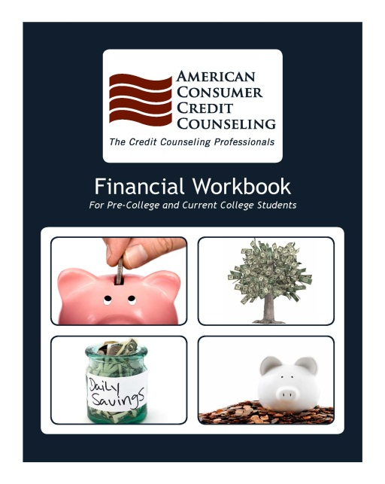
Workbooks Click book to download
Preschool- 2nd grade
Grades 3-6
Grades 7-12
Pre-college and current college students

Slide 10
Contact Us
866-826-7090
130 Rumford Ave, Suite 202
Auburndale, MA 02466

